Slide 1
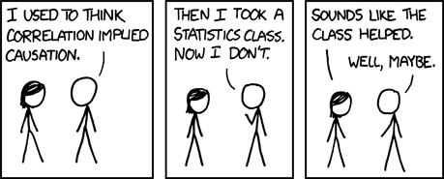
Introduction to Experimental Design
ENTMLGY 6702 Entomological Techniques and Data Analysis

Slide 2
Learning objectives
Define key steps and terms in experimental design
Compare and contrast methods of treatment allocation
Practice writing and using a linear model
Discuss potential actions following a failed experiment
Evaluate advantages and disadvantages of observational studies

Slide 3
Some vocabulary
Null hypothesis (H₀):(1) measurements – most commonly we are interested in means/averages - do NOT differ significantly among or between treatments or populations; any observed differences arise due to random chance (e.g., sampling, experimental noise). (2) measurements do not differ significantly from 0.
Alternative hypothesis (H_{a}): (1) measurements (means) differ significantly among or between treatments or populations. (2) measurements are significantly different from 0.
Experimental Unit: the smallest entity to which a treatment is applied
Unit of observation: the unit at which data are collected (you will sometimes see “sampling unit” used equivalently)
Unit of analysis: the unit at which data are analyzed (frequently – but not always – the same as the unit of observation)

Slide 4
Apply it
Null hypothesis (H₀):(1) measurements – most commonly we are interested in means/averages - do NOT differ significantly among or between treatments or populations; any observed differences arise due to random chance (e.g., sampling, experimental noise). (2) measurements do not differ significantly from 0.
Alternative hypothesis (H_{a}): (1) measurements (means) differ significantly among or between treatments or populations. (2) measurements are significantly different from 0.
Experimental Unit: the smallest entity to which a treatment is applied
Unit of observation: the unit at which data are collected (you will sometimes see “sampling unit” used equivalently)
Unit of analysis: the unit at which data are analyzed (frequently – but not always – the same as the unit of observation)
Activity: Think of one experiment or study from your thesis (completed or planned). What are the hypotheses, experimental unit, and unit of observation?

Slide 5
Experimental design: key principles
For each term:
Explain its importance in designing robust experiments.
Explain how each would be achieved “in the real world.”
Randomization
Replication
Reduction of noise

Slide 6
Experimental design: key principles
Randomization: the random allocation of treatments to experimental units.
Allocation should actually be based on something random. That is, haphazard ≠ random.
Protect against biases
Helps one meet assumptions of independence
enables statistical analysis
Note that treatments may include things that are categorical (e.g., presence of thinning or an insecticide) OR continuous (e.g., target basal area or application rate).
Replication: the repetition of a treatment within an experiment.
Reduce the effect of uncontrolled variation
Increase precision
Quantify uncertainty
Reduction of noise: by controlling as much as possible the conditions in the experiment.

Slide 7
Experimental design (Hurlbert 1984)
Specify:
Nature of the experimental units
Numbers and kinds of treatments to be imposed
Properties or responses that will be measured
Manner in which treatments are assigned to experimental units
Number of experimental units receiving each treatment (replicates)
Physical (spatial) arrangement of units
Temporal sequence of treatment application

Slide 8
Types of experiments
Mensurative: taking measurements at one or more points in time or space; no imposition of experimental treatments. The “treatments” or “predictors” are implemented by taking advantage of spatiotemporal variation.
Sometimes called observational.
Manipulative: different experimental units receive different treatments.

Slide 9
Experimental design: the variables
Response variable: aka dependent variable. A random variable whose value depends on that of another. Often represented using y or Y. Measured at your unit of observation.
Predictor variable: aka independent or explanatory variable. You select “treatments” to be measured at experimental units (mensurative) or assign treatments of some primary factor to experimental units (manipulative). Determine if and what controls are necessary. Often represented using x or X.
“Nuisance” variable: random variable that is of no particular interest but that likely affects your response variable (potentially for reasons unknown).

Slide 10
“Controls”
In a broad sense, control means to reduce the amount of noise or variation (e.g., get instruments serviced, avoid or account for natural gradients in experiments).
Control groups (vs. treatment groups)
Untreated: no imposition of an experimental variable
Treated: procedural treatment
Positive control: a control in which you expect a response
Negative control: a control in which you do not expect a response
The goal is to isolate - as much as possible – the effect of the treatment by accounting for confounding variables (e.g., procedural or temporal changes in your response).
Exercise: You are interested in growth rates of a newly discovered plant pathogenic fungi on different media. You plan to inoculate each medium by transferring the spores from plants using a cotton swab. Can you think of positive and negative controls you might want to include?

Slide 11
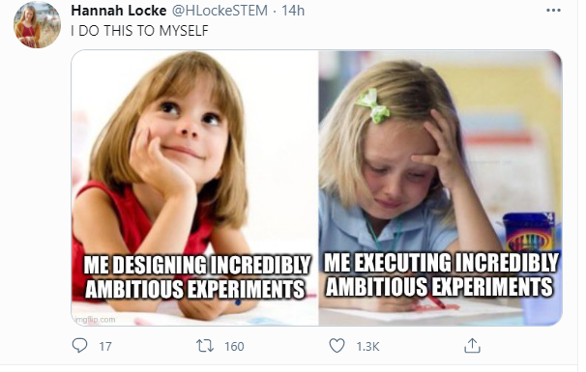
Absence of controls
Lots of studies don’t have “true controls” (e.g., comparing herbivory on two different species of plants).
Think hard about the biology AND experimental protocols (e.g., does the design require several manipulations that might have unwanted effects?) to determine if you need a control.

Slide 12
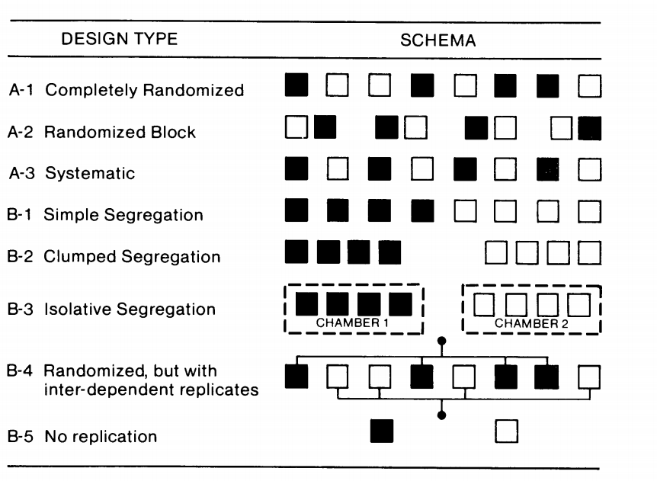
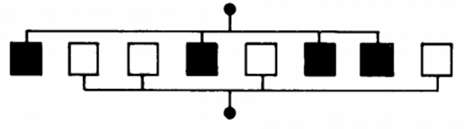
Allocating treatments
A.
F.
B.
G.
H.
C.
Isolative segregation
No replication
Randomized, but with inter-dependent replicates
Randomized block
Clumped segregation
Completely randomized
Systematic
Simple segregation
D.
E.

Slide 13
Allocating treatments
A.
F.
Isolative segregation
Simple segregation
B.
G.
Randomized block
Completely randomized
H.
No replication
C.
Clumped segregation
Part 2: Identify which ones you would feel comfortable using. Be prepared to explain your reasoning.
D.
Randomized, but with inter-dependent replicates
E.
Systematic

Slide 14

Simple experiment
Measure growth of plants (biomass of individuals, g) as a function of three different fertilizers (A = none/control, B = Ammonium sulfate, and C = Urea). The fertilizer will be applied to a 20×20cm² plot around the base of each plant in spring (assume no interference between fertilizers on adjacent plants). In autumn, the above ground biomass (AGB) of each plant will be cut, dried, and weighed.
Identify:
Experimental Unit
Unit of observation
Null hypothesis
Alternative hypothesis (or at least one potential one)
single plant

Slide 15
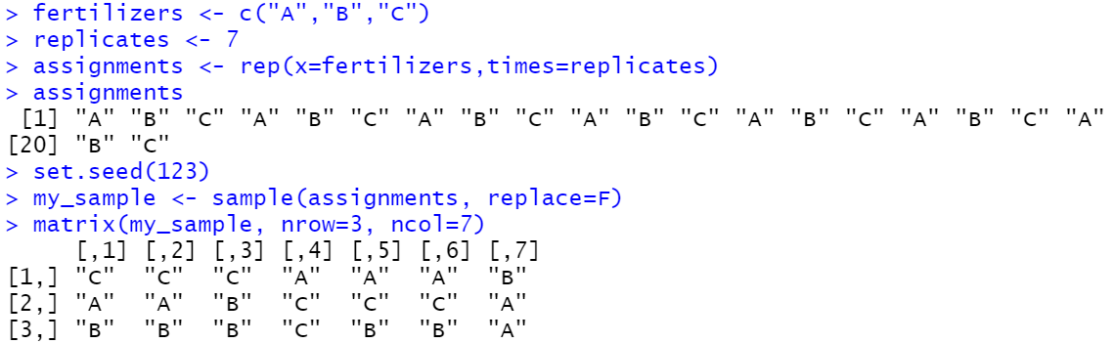
Completely randomized design
Sampling universe (e.g., farm)
A
B
C
single plant

Slide 16
Quick refresher on notation
Y = (4,8,1,1,30,5)
Y₁ =4
Y₅ =30

Slide 17
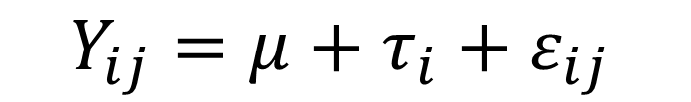
Linear model
$$Y_{ij}=μ+τ_{i}+ε_{ij}$$
Response
Predictors
Y_{ij} is the value for the jth observation in the ith level of the treatment.
µ is the overall mean (average) across all observations
τ_{i} is the effect, or the difference between the ith level of the treatment τ and the overall average (µ)
ε_{ij} is the error, or the remaining difference between the jth observation and the mean of the ith treatment

Slide 18
Linear model
$$Y_{ij}=μ+τ_{i}+ε_{ij}$$
Response
Predictors
Y_{ij} is the value for the jth observation in the ith level of the treatment.
µ is the overall mean (average) across all observations
τ_{i} is the effect, or the difference between the ith level of the treatment τ and the overall average (µ)
ε_{ij} is the error, or the remaining difference between the jth observation and the mean of the ith treatment
For our plant growth experiment, let’s say the overall mean AGB was 34g and plants in treatments A, B, and C had average AGBs of 30g, 32g, and 40g, respectively. The biomass of the first plant, which was in treatment C, was 42g (Y_{C1} = 42).
Exercise: With this information, find ε_{C1}
µ = 34
τ_{A} =30-34=-4
τ_{B} =32-34=-2
τ_{C} = 40-34=6
Y_{C1} = µ + τ_{C} + ε_{C1}
42 = 34 + 6 + ε_{C1}
ε_{C1} = 2
ε_{3,1} = 2
ε_{ij} = observed-expected = Y_{ij}-(𝜇+τ_{i} )

Slide 19
Completely randomized design
Sampling universe (e.g., farm)
A
B
C
single plant

Slide 20
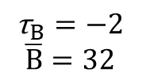
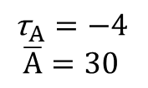

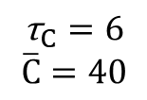
Linear model
$$Y_{ij}=μ+τ_{i}+ε_{ij}$$
Response
Predictors
µ
$$\text{µ}=34$$
τ_{A}
τ_{B}
τ_{C}
25
32
32
24
26
30
36
36
42
38
40
44
28
33
36
29
35
32
33
44
39
$${\text{τ}}_{A}=−4$$
$$\overline{A}=30$$
$${\text{τ}}_{B}=−2$$
$$\overline{B}=32$$
$${\text{τ}}_{C}=6$$
$$\overline{C}=40$$
Y_{C1}
Units = biomass of plants in grams

Slide 21

Completely randomized design
Let’s add more plants and another treatment.
Challenge plants with herbivory: inoculation of plants with 10 aphids vs. no inoculation (control).
Sampling universe (e.g., farm)
A
B
C
single plant

Slide 22
Completely randomized design (CRD; factorial)
Sampling universe (e.g., farm)
single plant

Slide 23
Completely randomized design (CRD; factorial)
A
B
C
Sampling universe (e.g., farm)
single plant
10 aphids

Slide 24
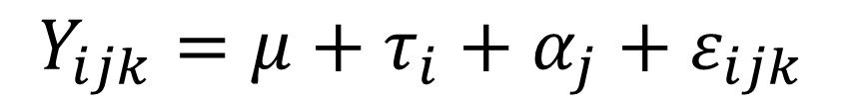
Linear model
$$Y_{ijk}=μ+τ_{i}+α_{j}+ε_{ijk}$$
Response
Predictors
Y_{ij} is the value for jth observation in the ith level of the treatment.
µ is the overall mean (average) across all observations
τ_{i} is the effect, or the difference between the ith level of the treatment τ and the overall average (µ)
Now we have another treatment (aphids)…so we need another parameter:
α_{j} is the effect, or the difference between the jth level of the treatment α and the overall average (µ)
ε_{ijk} is the error, or the remaining difference between the kth observation and the mean of observations in the ith treatment and jth treatment levels

Slide 25
Linear model
$$Y_{ijk}=μ+τ_{i}+α_{j}+ε_{ijk}$$
µ
τ_{A}
τ_{B}
τ_{C}
α_{Yes}
α_{No}
α_{Yes}
α_{No}
α_{Y}
α_{N}
This is just one way to visualize…and DOES NOT indicate that one treatment is nested within the other.
Y_{A,Yes,1}

Slide 26
Linear model
$$Y_{ijk}=μ+τ_{i}+α_{j}+ε_{ijk}$$
µ
α_{Y}
α_{N}
τ_{A}
τ_{B}
τ_{C}
τ_{A}
τ_{B}
τ_{C}
Y_{A,Yes,1}

Slide 27
Linear model
$$Y_{ijk}=μ+τ_{i}+α_{j}+τα_{ij}+ε_{ijk}$$
Response
Predictors
We can also evaluate interactions between our treatments (e.g., does response of plants to different fertilizer levels change when plants are challenged with aphids?)
We’ll cover interactions in detail later on when we cover Analysis of Variance!

Slide 28
Observational studies
Observational studies: when the independent or dependent variables are not manipulated by the researcher.
In observational studies, your ability to infer cause-effect relationships is limited.
Examples?
Notes:
Measure a variable over time on the same subjects that might differ on a specific factor (e.g., tracking tree growth rates through time and comparing between species)
Measure variables in the field at a single point in time and quantifying the relationship (e.g., allometric equations, does diameter at the root collar correlate with whole plant biomass? Is that relationship linear or curvilinear?)
Database integration (e.g., does county-level occurrence of emerald ash borer (data base 1) change with human population density (data base 2) and/or temperature (date base 3)?

Slide 29
Examples
Measure a variable over time on the same subjects that might differ on a specific factor (e.g., tracking tree growth rates through time and comparing between species)
Measure variables in the field at a single point in time and quantifying the relationship (e.g., allometric equations, does diameter at the root collar correlate with whole plant biomass? Is that relationship linear or curvilinear?)
Database integration (e.g., does county-level occurrence of emerald ash borer (data base 1) change with human population density (data base 2) and/or temperature (date base 3)?

Slide 30
What to do if my experiment fails?
Depends on the reason for failure. It’s difficult to give broadly applicable advice, but any steps you might take to rescue an experiment should be ethical (i.e., don’t “torture the data until it confesses”).
Some things you might try:
Repeat the experiment if possible (often it’s not), assuming failure was not due to a design flaw
Combine your data with an existing data base
Did you lose a treatment? Is there a simpler, meaningful analysis you can still try?
Can you answer the question with a meta-analysis? (more on this in a moment…)
Null or “negative” results: Publication bias → authors are more likely to publish when they have statistically significant results (“file drawer problem”)
One hallmark of good research: asking questions that are interesting no matter the answer (easier said than done, of course!).

Slide 31
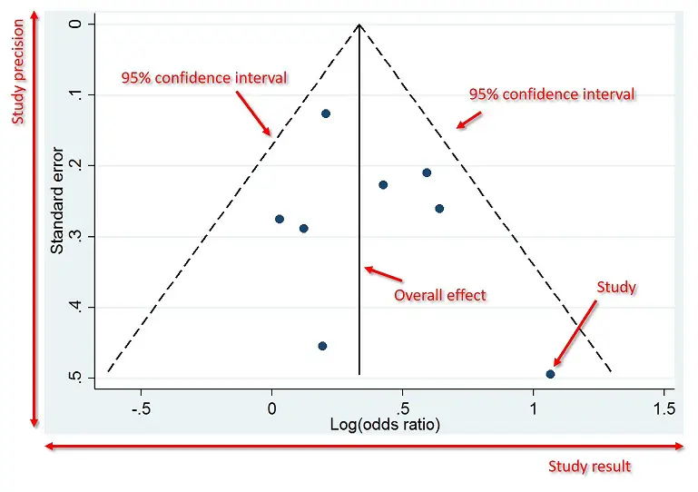
File drawer problem (funnel plots)
https://toptipbio.com/funnel-plot/

Slide 32
Meta-analyses
Modern systematic reviews and meta-analyses
State question(s) to be addressed in review.
Annotated bibliographies vs. formal meta-analyses
Define in advance and report the following things
methods used to locate studies
list of data to be extracted, and derivation methods, if needed
criteria for inclusion (and exclusion) of results based on methods used not results themselves
define comparisons to be made among subgroups of studies
Summarize and analyze results in combined studies
List studies found
Explain why any were excluded
Forest plots
Combined, precision weighted estimate of effect(s)
Contrast subgroups
Sensitivity analysis (“jacknife” and other procedures)
Assess publication bias (file drawer effect) and methodological bias with a funnel plot

Slide 33
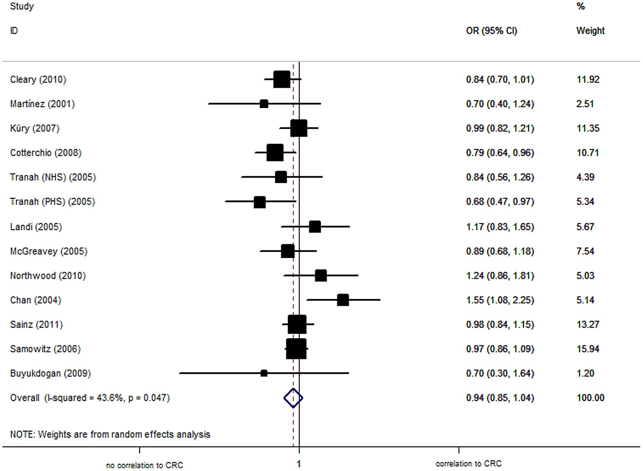

Forest plot example
Forest plots: graphical summary of means and variances (often 95% confidence intervals or standard errors) for each study and overall effect

Slide 34
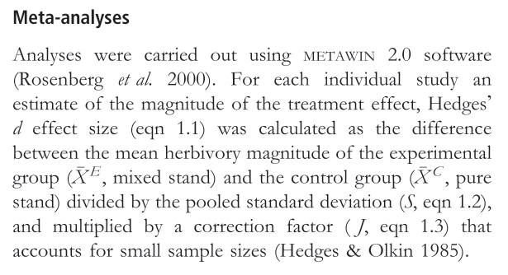
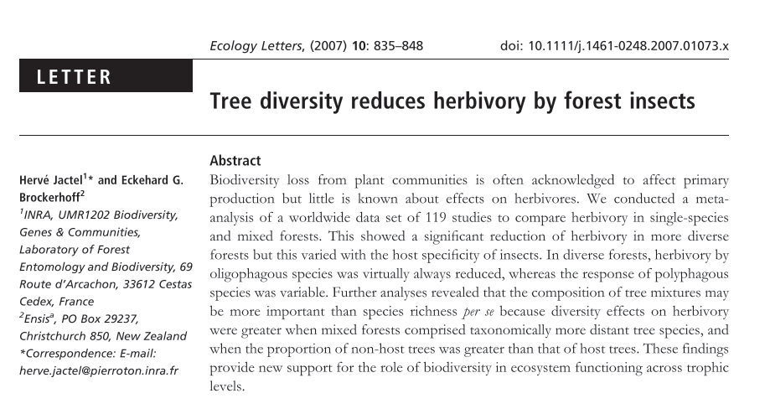
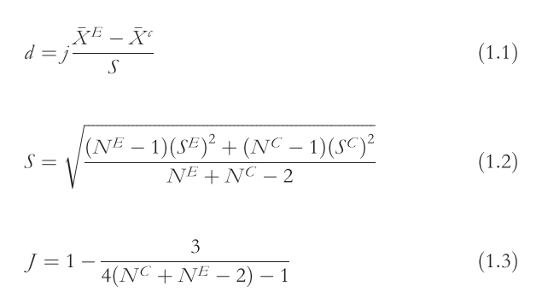
Meta-analyses (example)

Slide 35
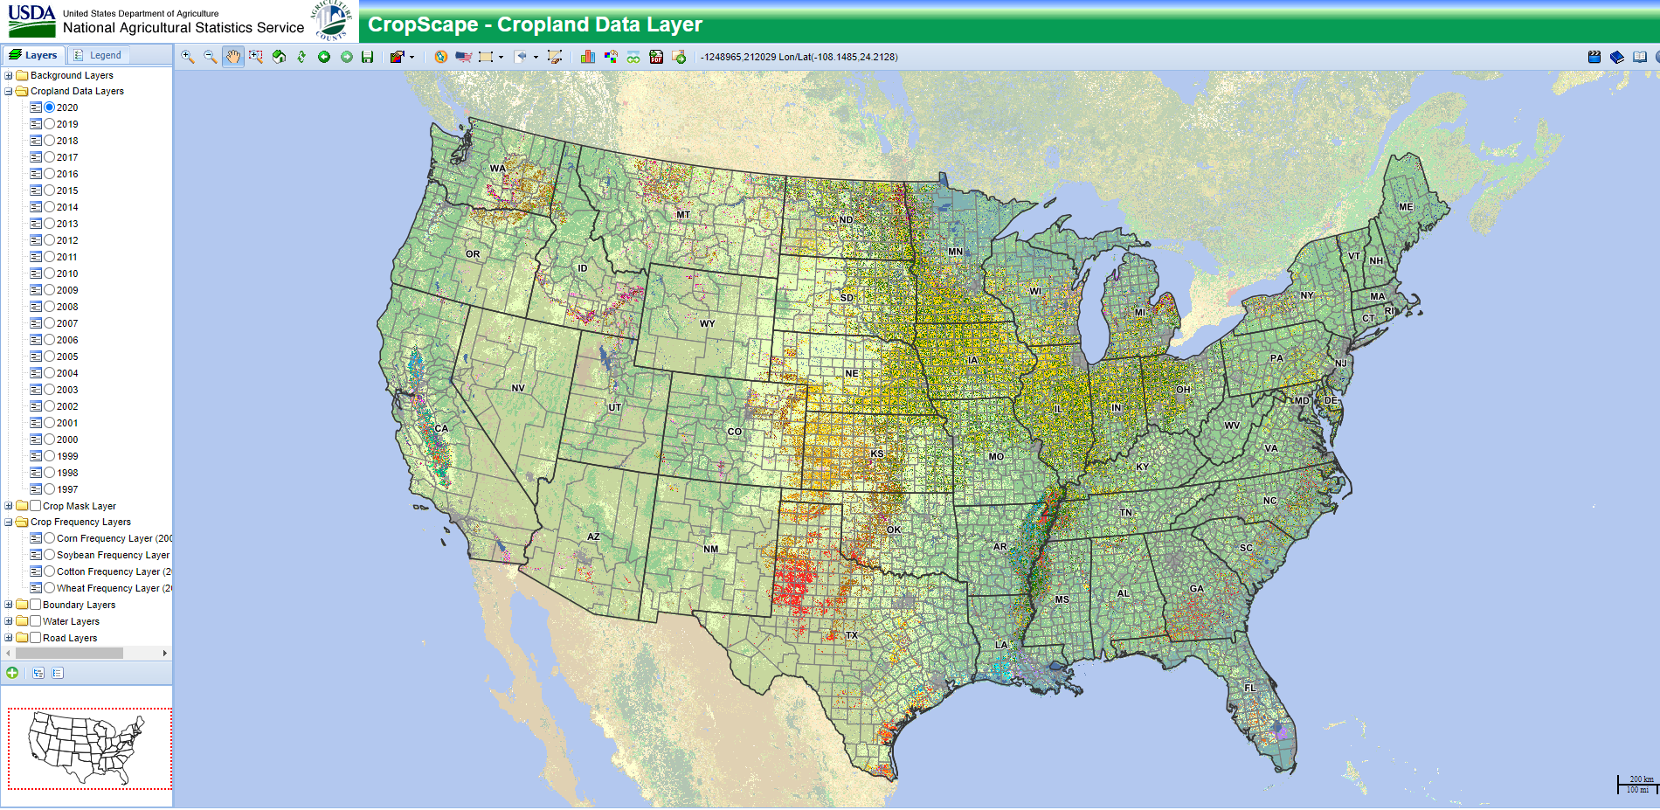






Open source data
USDA Forest Service
USDA (e.g., CropScape)
PRISM (climate rasters)
USGS (e.g., remote sensing)
US Census (human population density)
NSF (National Ecological Observatory Network)

